Slide 1

DESIGNING MONOLITH FIRST FOR MICROSERVICE ARCHITECTURE
Halil İbrahim Kalkan

Slide 2

Agenda
TODO: ...

Slide 3
INTRODUCTION
DESIGNING MONOLITH FIRST FOR MICROSERVICE ARCHITECTURE

Slide 4

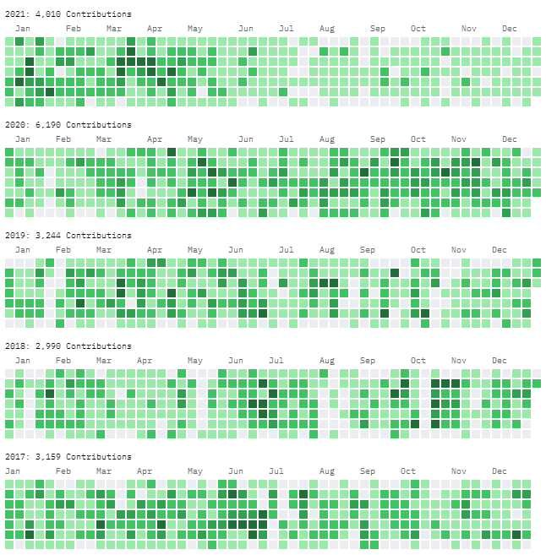
About me: Halil İbrahim Kalkan
halilibrahimkalkan.com
GitHub: hikalkan
Twitter: hibrahimkalkan

Slide 6
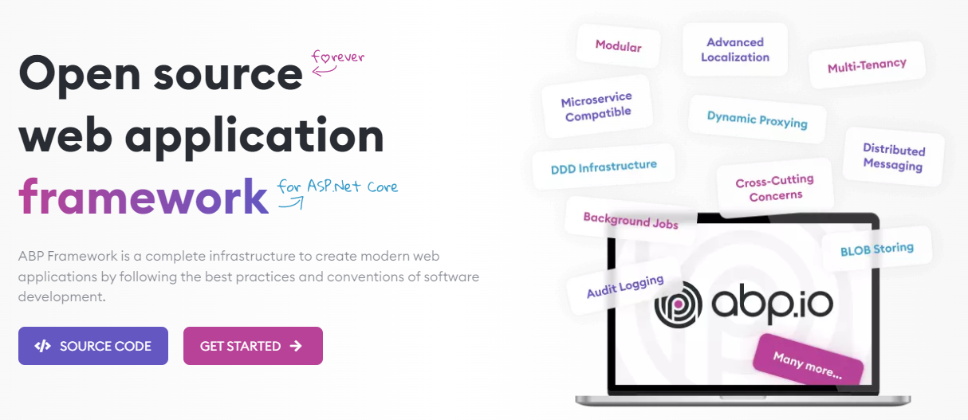
The ABP FRAMEWORK project https://abp.io --- https://github.com/abpframework

Slide 7
ABP Framework: Architecture
Domain Driven Design
& Layered Solution
Modular
Multi-Tenancy (SaaS infrastructure)
Microservice ready

Slide 8
ABP Framework: Infrastructure Enterprise application requirements
Cross-cutting concerns
Authentication & authorization
Distributed event bus
Audit logging
Background jobs
Data filtering & soft-delete
Dynamic client-side proxies
Dynamic forms
…more

Slide 9
ABP Framework: Startup templates

Slide 10
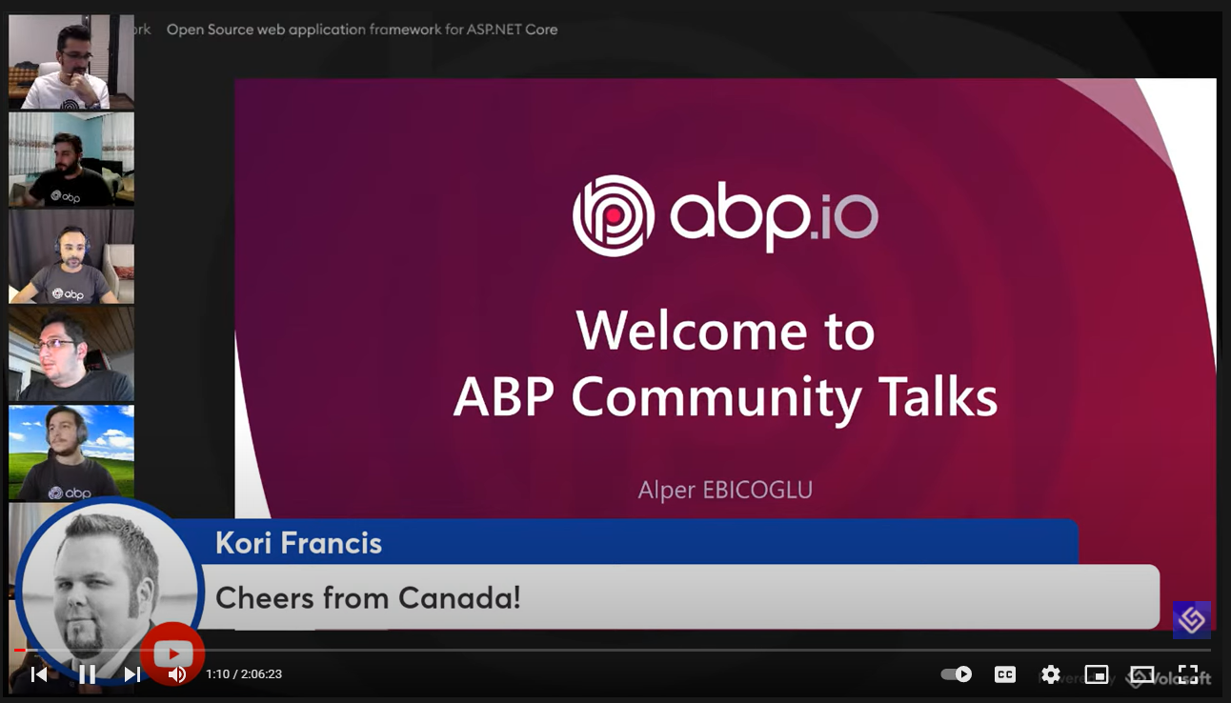
ABP Framework: The community
GitHub
8K stars
24,000 commits
238 contributors
6,200 issues & 5,200 PRs closed
NuGet
128 releases
5M downloads (only for the core package)
ABP Community Talks

Slide 11
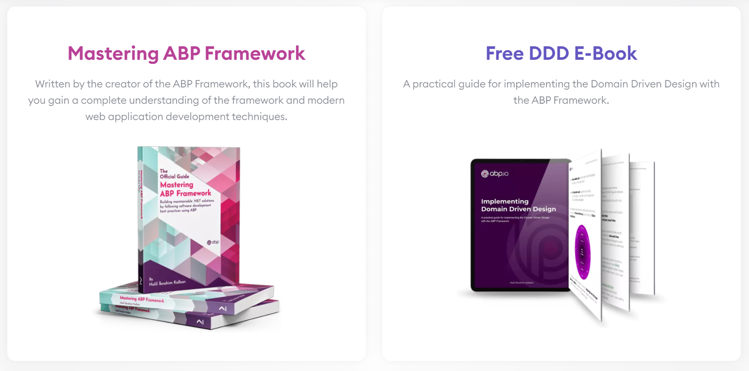
ABP Framework: Books

Slide 12
eShopOnX projects
eShopOnContainers (by Microsoft) https://github.com/dotnet-architecture/eShopOnDapr
Simplified and containerized microservice example
Show drafts of different architectural patterns
Not production ready
eShopOnDapr (by Microsoft) https://github.com/dotnet-architecture/eShopOnDapr
Based on eShopOnContainers, powered by Dapr
Focuses on demonstrating the Dapr features
More production ready, applicable and maintainable
eShopOnAbp (by Volosoft) https://github.com/abpframework/eShopOnAbp
Reference solution for microservice development with the ABP Framework and state-of-the-art tools
Production ready, easy to develop and maintain

Slide 13
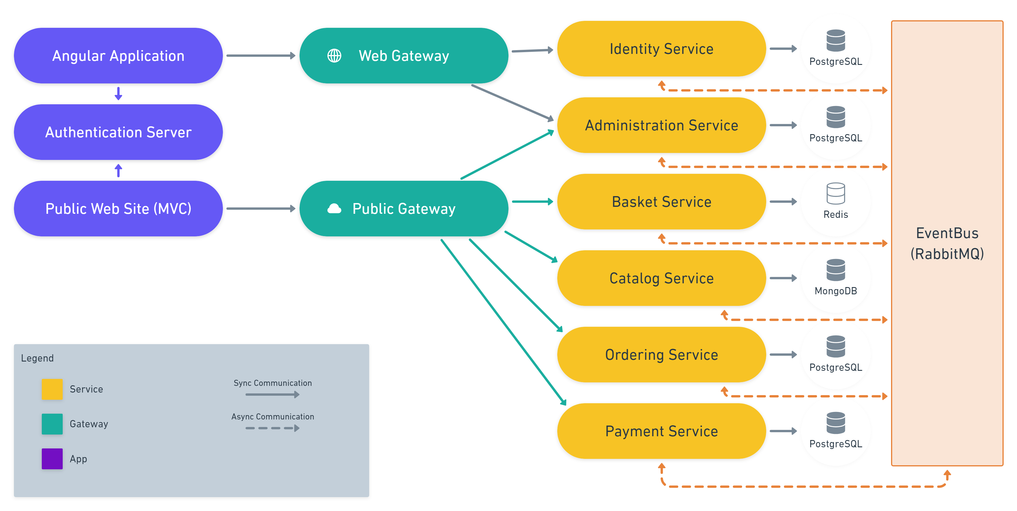
eShopOnAbp https://github.com/abpframework/eShopOnAbp

Slide 14
eShopOnAbp https://github.com/abpframework/eShopOnAbp
TODO: More details and the book!

Slide 15
Microservice trade-offs
BENEFITS
Forcing the modularity and encapsulation
Independently developed, deployed and scaled
Technology diversity
COSTS
Distribution
Eventually consistency
Operational complexity
Reference: https://martinfowler.com/articles/microservice-trade-offs.html

Slide 16


Microservices: Who is for?
Large development team with DevOps and automation culture
Large, complex and mature business or domain

Slide 17
Microservices: Who is (not) for?
My primary guideline would be don't even consider microservices unless you have a system that's too complex to manage as a monolith. The majority of software systems should be built as a single monolithic application. Do pay attention to good modularity within that monolith, but don't try to separate it into separate services.
--- Martin Fowler https://martinfowler.com/bliki/MicroservicePremium.html

Slide 18
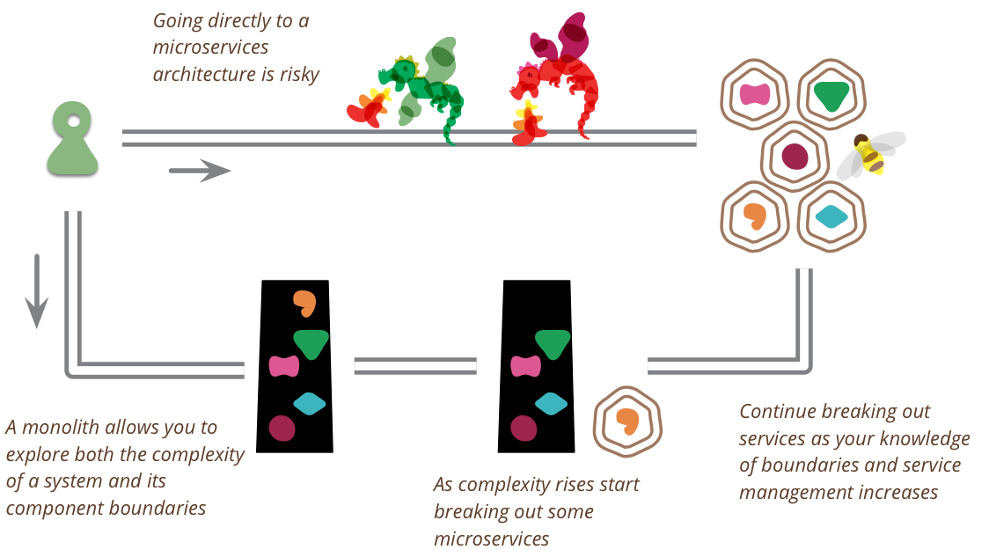
Monolith first: What?
You shouldn't start a new project with microservices, even if you're sure your application will be big enough to make it worthwhile.

Slide 19
Monolith first: Why?
YAGNI: Create a simplistic version first, maybe it won’t succeed.
Fast MVP, shorter time to market
Service boundaries & business requirements are not clear –refactoring a monolith is easier than a microservices
You’ve a small team

Slide 20
Monolith first: How?
Build as monolith (not modular), discard it and replace with microservices at some point
Build as monolith (may not be fully modular), introduce microservices by the time (keep the core as monolith for a while)
Create coarse-grained (large) services, then break down into finer-grained services as boundaries stabilize
Design a fully modular monolith, then migrate to microservices when it gets mature

Slide 21
Monolith first: When not?
You are already replacing a legacy monolith or distributed system!

Slide 22
DESIGNING A MODULAR MONOLITH
DESIGNING MONOLITH FIRST FOR MICROSERVICE ARCHITECTURE

Slide 23
The need for layering
DESIGNING A MODULAR MONOLITH

Slide 24
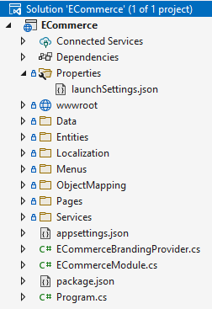
The need for layering Single-project solution
Data access logic
Business logic
Hosting logic
User interface

Slide 25


The need for layering Backend-frontend separation
Database
Data access logic
Business logic
Backend Application
Database
HTTP (REST) API
API Hosting logic
Data access logic
Business logic
API Gateway
User interface
Hosting logic
User interface
Frontend Application
UI Hosting logic
Browser / User
Browser / User

Slide 26
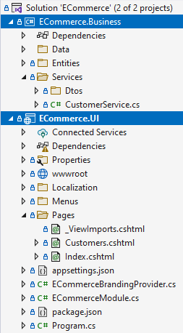
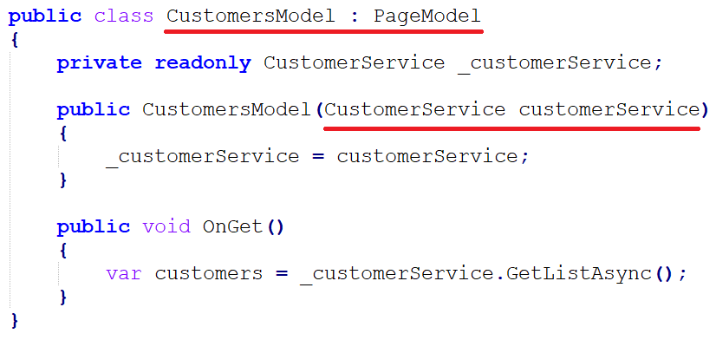
The need for layering Separating UI from business
ECommerce.UI --- (depends) ---> Ecommerce.Business

Slide 27
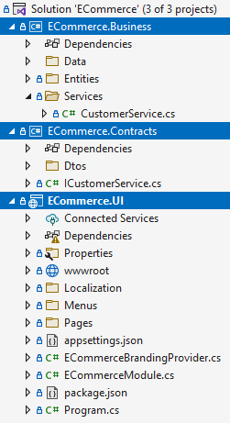
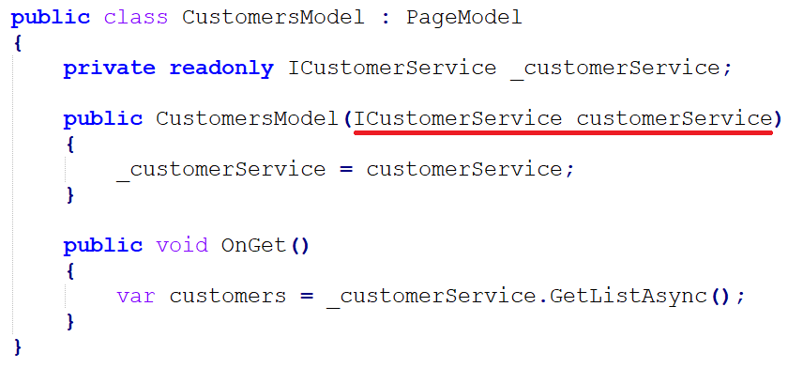
The need for layering Introducing business contracts
ECommerce.UI --- (depends) ---> ECommerce.Contracts
ECommerce.Business --- (depends) ---> ECommerce.Contracts

Slide 28
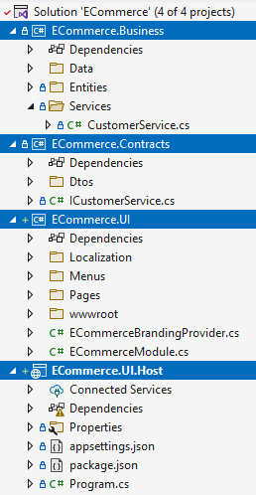
The need for layering Separating the hosting project
ECommerce.UI --- (depends) ---> ECommerce.Contracts
ECommerce.Business --- (depends) ---> ECommerce.Contracts
ECommerce.UI.Host --- (depends) ---> ECommerce.UI
ECommerce.Business

Slide 29

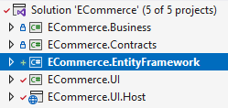
The need for layering Separating the data access project

Slide 30
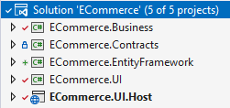
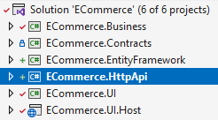
The need for layering Adding HTTP (REST) APIs

Slide 31
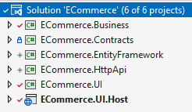
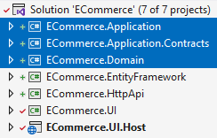
The need for layering Implementing layering for Domain-Driven Design

Slide 32
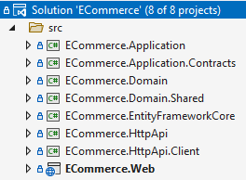
The need for layering ABP’s layered module solution structure
Domain.Shared
Domain
EF Core
Application.Contracts
Application
HttpApi.Client
HttpApi
Web

Slide 33
The need for layering Hosting as a monolith
Domain.Shared
Domain
EF Core
Application.Contracts
Application
HttpApi.Client
HttpApi
Monolith Hosting
Application
Web

Slide 34
The need for layering Hosting in different applications
Background Service Application
Domain.Shared
Domain
EF Core
Client Application
Application.Contracts
Application
HttpApi.Client
HttpApi
Service Hosting Application
UI Hosting Application
Web
HTTP API calls

Slide 35
The need for layering Hosting a modular monolith
Customer module
Order module
Payment module
Basket module
Monolith Host Application

Slide 36
Designing the database
DESIGNING A MODULAR MONOLITH

Slide 37
Designing the database Single (shared) database approach
+ Easy to develop, test, deploy and maintain
- All modules should use the same database technology
- Should care about the data isolation between modules
Database
Customer module
Order module
Payment module
Basket module
Monolith Host Application

Slide 38
Designing the database Single (shared) database approach
Restrict access for each module with different connection strings, so modules can’t use other modules’ data (separate schemas)
Separate DbContext classes for Entity Framework Core
Unify EF Core database migrations
Database
Customer module
Order module
Payment module
Basket module
Monolith Host Application

Slide 39
Designing the database Separate (multiple) database approach
- Harder to develop, test, deploy and maintain
+ Every module may use the best database technology for its purpose
+ You don’t care about the data isolation between modules
HYBRID: Separate database whenever you need a different database technology for a module
Customer module
Order module
Payment module
Basket module
Monolith Host Application

Slide 40
Designing the database Module specific DbContext classes

Slide 41
Designing the database Unified DbContext for database migrations

Slide 42
Designing the database Database connection string management
TODO:
DbContext selection
Connection string selection
Managing database connections and transactions

Slide 43
Designing the database Common principles
Do not access to other modules’ database
Do not perform JOIN queries across different modules
Denormalize/duplicate data when needed
Asynchronously update the duplicated data if necessary
Create reporting module(s) with its own tables/databases – feed them using distributed events
ABP provides auto distributed events for all entities

Slide 44
Integrating the modules
DESIGNING A MODULAR MONOLITH

Slide 45
Integrating the modules Common principles
A module should not touch other module’s internal APIs and database
Should talk with public integration APIs (synchronous communication) and distributed events (asynchronous communication)

Slide 46
Integrating the modules Synchronous communication
Create integration services (internal application services)
Best for;
Read (query) operations
Repeatable (idempotent) write (update/delete) operations
Don’t assume database transaction for inter-module operations
Use caching for read operations (especially for critical performance paths)
Use data duplication (and synchronization) to perform local database table JOINs
Monolith Host (single process)
Order module
Customer module
Query customer

Slide 47
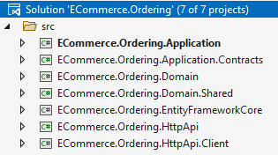
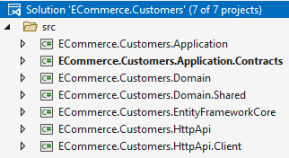
Integrating the modules Synchronous communication: project dependencies
Reference to Customers.Application.Contracts (or Customers.Integration.Contracts) project
Monolith hosting application brings the implementations together
Microservice hosting application uses the Customers.HttpApi.Client project

Slide 48

Integrating the modules Synchronous communication: caching
Monolith Host (single process)
Order module
Customer module
Query customer
Distributed cache
Not found in the cache
Invalidate the cache
Found in the cache

Slide 49
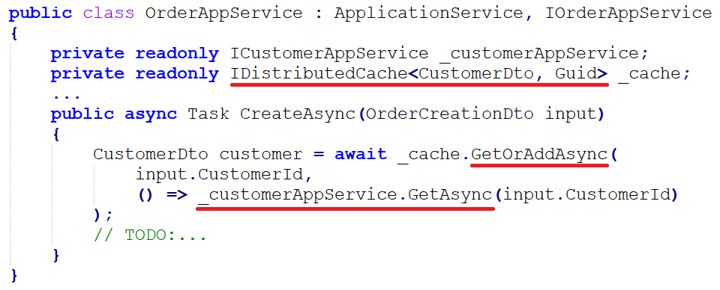
Integrating the modules Synchronous communication: caching

Slide 50
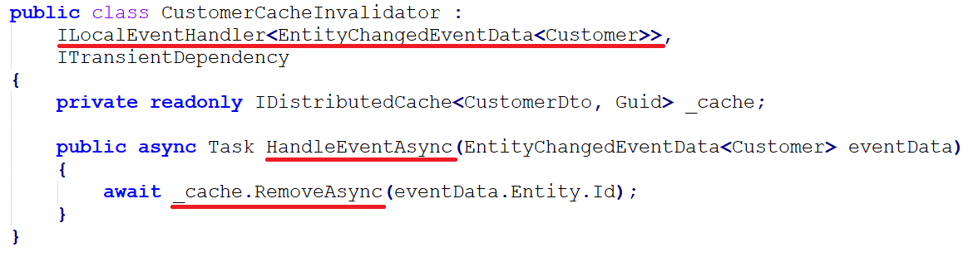
Integrating the modules Synchronous communication: caching

Slide 51

Integrating the modules Synchronous communication: data duplication
(4)
(1) Query local database
(2) Use local data
(4) Update local data
(7)
(2)
(1)
(7) Update local data
Monolith Host (single process)
Order module
Customer module
(3) Query customer (potentially use cache)
Distributed Event Bus
(6) Change event
(5) Change event

Slide 52
Integrating the modules caching vs data duplication
TODO: SHOW CODE FROM ABP

Slide 53
Integrating the modules caching vs data duplication
Caching
+ Faster & lightweight
+ Doesn’t need synchronization
- Only individual access to the cached data
- Limited offline access
Use if you only need to query individual data
Data duplication
- Slower (database operations)
- Needs synchronization
+ Individual and mass access (JOIN queries) to the duplicated data
+ Better offline access
Use if you need to query mass data
YOU CAN ALWAYS COMBINE TOGETHER

Slide 54
Integrating the modules caching vs data duplication
TODO: ...

Slide 55
Integrating the modules caching vs data duplication
TODO: ...

Slide 56
Integrating the modules caching vs data duplication
TODO: ...

Slide 57
Integrating the modules caching vs data duplication
TODO: ...

Slide 58
Integrating the modules caching vs data duplication
TODO: ...

Slide 59
Integrating the modules caching vs data duplication
TODO: ...

Slide 60
MIGRATING TO MICROSERVICES
DESIGNING MONOLITH FIRST FOR MICROSERVICE ARCHITECTURE

Slide 61
Title
TODO: ...

Slide 62
Title
TODO: ...

Slide 63
Title
TODO: ...

Slide 64
Title
TODO: ...

Slide 65
Title
TODO: ...

Slide 66
Title
TODO: ...

Slide 67
Title
TODO: ...

Slide 68
Title
TODO: ...

Slide 69
Title
TODO: ...

